Slide 1


PANIMALAR ENGINEERING COLLEGE
Department of Computer Science and Engineering
CS8811 PROJECT WORK
Title of the Project: SKILL AND JOB RECOMMENDATION SYSTEM USING FODRA
Project Guide: Dr. M. KRISHNAMOORTHY
Team Members with Register number
SANJEEV P N 211419104234
SANTHOSH J 211419104235
SARATH S 211419104238
Batch Number: C06

Slide 2
INTRODUCTION
To develop an enhanced web application, using web services for both online job and candidate recommendation system.
By using Four Dimensions Recommendation Algorithm (FoDRA) and Text field filtering the recommendation of jobs and candidates will be classified. Three tier architecture designs have been implemented for efficient data retrieval and data transfer.
They are Job seeker interface, Candidate recruitment interface and Admin will be the architecture taken for developing this application.
The primary architecture will be the job seeker interface, in followed with candidate recruitment interface and Admin will be interconnected.
The professional social recommender will work as a third-party agent and the agent will retrieves all the recommended job and candidate profiles.
A panel will be designed for displaying the recommended job and candidate details.
All the displayed jobs will be more relevant to the user’s profile.

Slide 3
LITERATURE SURVEY
S.NO | PAPER NAME | AUTHOR NAME | LINK
1 | Efficient and Scalable Job Recommender System Using Collaborative Filtering. | Ravita Mishra and Sheetal Vikram Rathi | CLICK HERE
2 | FoDRA — A new content-based job recommendation algorithm for job seeking and recruiting | Nikolas D. Almalis, George A. Tshrintzis, Nikolaos Karagiannis, Aggeliki D. Strati | CLICK HERE

Slide 4
PROBLEM STATEMENT
An employment portal is an application that facilitates the search for employment and ranges from large, generalized sites to specialized working groups for work categories such as engineering, law, insurance, social work, teaching, and developing mobile applications.
Users can usually submit their resumes and send them to potential employers and recruiters for review, while employers and recruiters can post job postings and search for potential employees.
Our Job Portal System will provide a very specific way to eliminate and reduce the time for the most appropriate role. The determination is to allow communication between the interested parties and complete the task of recruitment quickly.

Slide 5
TECHNOLOGY STACK
SOFTWARE SPECIFICATION
LANGUAGE : JAVA
IDE : JAVA NETBEANS
DATABASE : SQL
CODINGS SPECIFICATION
FRONT END : HTML, CSS
CONNECTIVITY : JSP, SQL
BACKEND : JAVA
HARDWARE REQUIREMENTS
PROCESSOR : INTEL I3
HARD DISK : MINIMUM 120 GB
RAM : MINIMUM 4GB
OS : WINDOWS 8 OR HIGHER

Slide 6
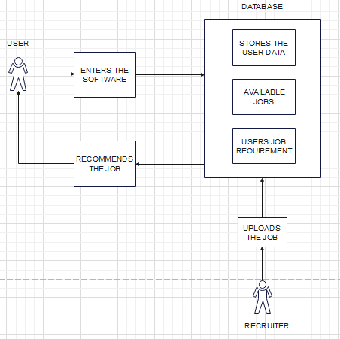
SYSTEM ARCHITECTURE

Slide 7
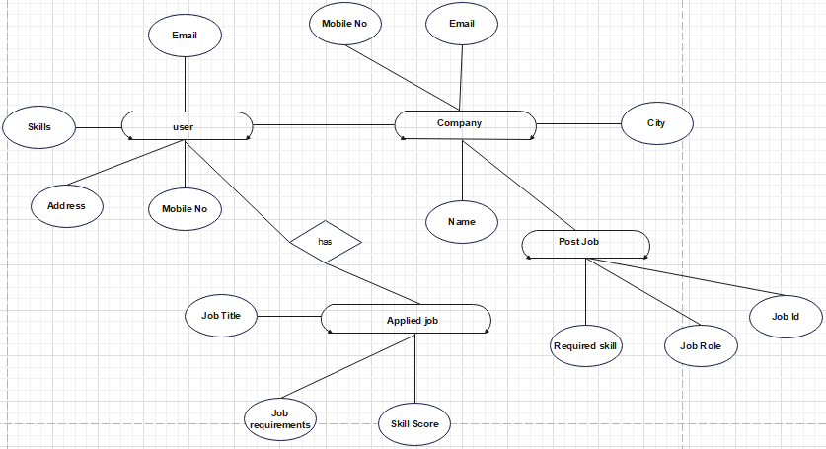
SYSTEM DESIGN
E-R DIAGRAM

Slide 8
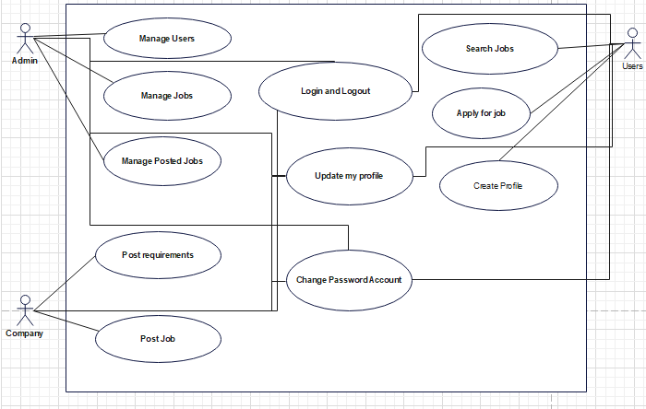
UML DIAGRAM

Slide 9
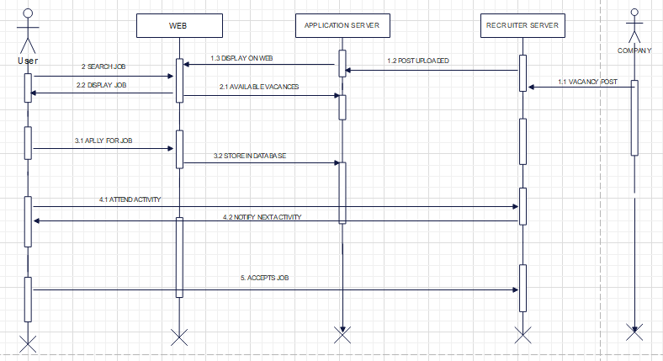
SEQUENCE DIAGRAM

Slide 10
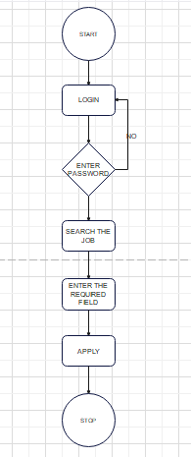
ACTIVITY DIAGRAM

Slide 11
MODULAR DESCRIPTION
JAVA
Java is one of the well known and well developed programming language which were widely used among the developers.
Java provides support for web application through servlet and JSPs which helps to create a website with static HTML pages.
There are three main approaches is to use a java servlet which is essentially a basic API(Application Programming Interface) that provides bare bone support to help web developers as it is more flexible.
The second approach makes use of java with JSF(Java Server Faces) which is a more complex API that provides more complex API than a servlet.
The approach that we are going to use is the first approach of Application Programming Interface that gives the required flexibility to our application in need for its development.

Slide 12
JSP
JSP pages are a third generation solution that can be combined easily with some second generation solutions, creating dynamic content, and making it easier and faster to build web-based applications that work with a variety of other technologies: web servers, web browsers, application servers and other development tools.
Java Server Pages (JSP) is a Web page development technology that supports dynamic content. This allows programmers to use specific JSP tags to insert Java code into HTML pages.
A part of Java Server Pages is a type of Java servlet designed to perform the function of a Java web application user interface. JSPs are written as text files by Web developers that incorporate Html or XHTML script, XML components, and embedded JSP actions and commands.
JSP tags may be used, such as downloading data from the database or recording user interests, accessing modules of JavaBeans, transferring power between sites, exchanging information among queries, etc.
JSP’s benefits are fairly straightforward as the dynamic component is implemented in Java, not Visual Basic or any platform-specific language, so it is smoother and simpler to use. Lastly, it is platform-independent.

Slide 13
HTML
HTML is also known as Hyper Text Markup Language.
Front-end engineers use HTML (along with other languages like CSS and JavaScript) to design the structure and layout of web pages and applications.
HTML is usually stored in files that use the .htm or .html extension.
HTML is a powerful coding tool for Web development. It is used to design and build websites. It plays a major role in the domain of Web development.
HTML has one of the simplest learning curves, as it doesn’t need any prior programming experience to learn HTML.
In or project of Skill and Job Recommendation using FoDRA Algorithm we created Front End page of our project using HTML language.

Slide 14
CSS
Cascading Style Sheets (CSS) is a stylesheet language used to describe the presentation of a document written in HTML or XML (including XML dialects such as SVG, MathML or XHTML). CSS describes how elements should be rendered on screen, on paper, in speech, or on other media.
CSS is among the core languages of the open web and is standardized across Web browsers according to W3C specifications.
CSS is used to style and layout web pages just as to alter the font, color, size, and spacing of your content, split it into multiple columns, or add animations and other decorative features.
This module provides a gentle beginning to your path towards CSS mastery with the basics of how it works, what the syntax looks like, and how you can start using it to add styling to HTML..
It is used to enhance the look of the front of our project Skill and Job Recommendation using FoDRA Algorithm.

Slide 15
SQL
Structured Query Language, abbreviated as SQL. SQL is a domain specific language used in programming and designed for managing data held in a Relational Database Management System(RDBMS), or for stream processing in a Relational Data Stream Management System(RDSMS).
The scope of SQL includes data query, data manipulation (insert, update, and delete), data definition (schema creation and modification), and data access control.
SQL is essentially a declarative language, it also includes procedural elements.
Allows users to access data in the relational database management systems.
Allows users to describe the data.
Allows users to define the data in a database and manipulate that data
In our project of Skill and Job Recommendation System using FoDRA algorithm we use SQL to store data of the users and the updates of the jobs are store in it.

Slide 16
NETBEANS
NetBeans is a popular Integrated Development Environment (IDE), written in Java.
It is primarily used for developing applications in Java, but it supports other languages too, such as PHP, C++, and HTML5.
NetBeans is an open-source IDE that can be run on multiple platforms such as Windows, Linux, and Mac OS.
The NetBeans IDE consists of a source code editor, build automation tools, and a debugger to help the programmers at every stage of software development.
In our project we use NetBeans as a Integrated Development Environment (IDE) to our project Skill and Job Recommendation using FoDRA Algorithm.
In the NetBeans the java language, JSP and SQL are integrated to show the output to the user.

Slide 17
TESTING
Black Box Testing
Black-box testing is a method of software testing that examines the functionality of an application (e.g. what the software does) without peering into its internal structures or workings.
This method of test can be applied to virtually every level of software testing: unit, integration, system and acceptance. It typically comprises most if not all higher level testing, but can also dominate unit testing as well.
Performance testing
In software engineering, performance testing is in general testing performed to determine how a system performs in terms of responsiveness and stability under a particular workload.
It can also serve to investigate, measure, validate or verify other quality attributes of the system, such as scalability, reliability and resource usage.
Performance testing is a subset of performance engineering, an emerging computer science practice which strives to build performance into the implementation, design and architecture of a system.
Test cases are built around specifications and requirements, i.e., what the application is supposed to do.

Slide 18
Test cases are generally derived from external descriptions of the software, including specifications, requirements and design parameters.
Although the tests used are primarily functional in nature, non-function tests may also be used.
The test designer selects both valid and invalid.
Testing will not catch every error in the program, since it cannot evaluate every execution path in any but the most trivial programs.
The same is true for unit testing. Additionally, unit testing by definition only tests the functionality of the units themselves.
RESULT
Thus the required software testing were completed in the Skill and Job Recommendation System and the software is being deployed.

Slide 19
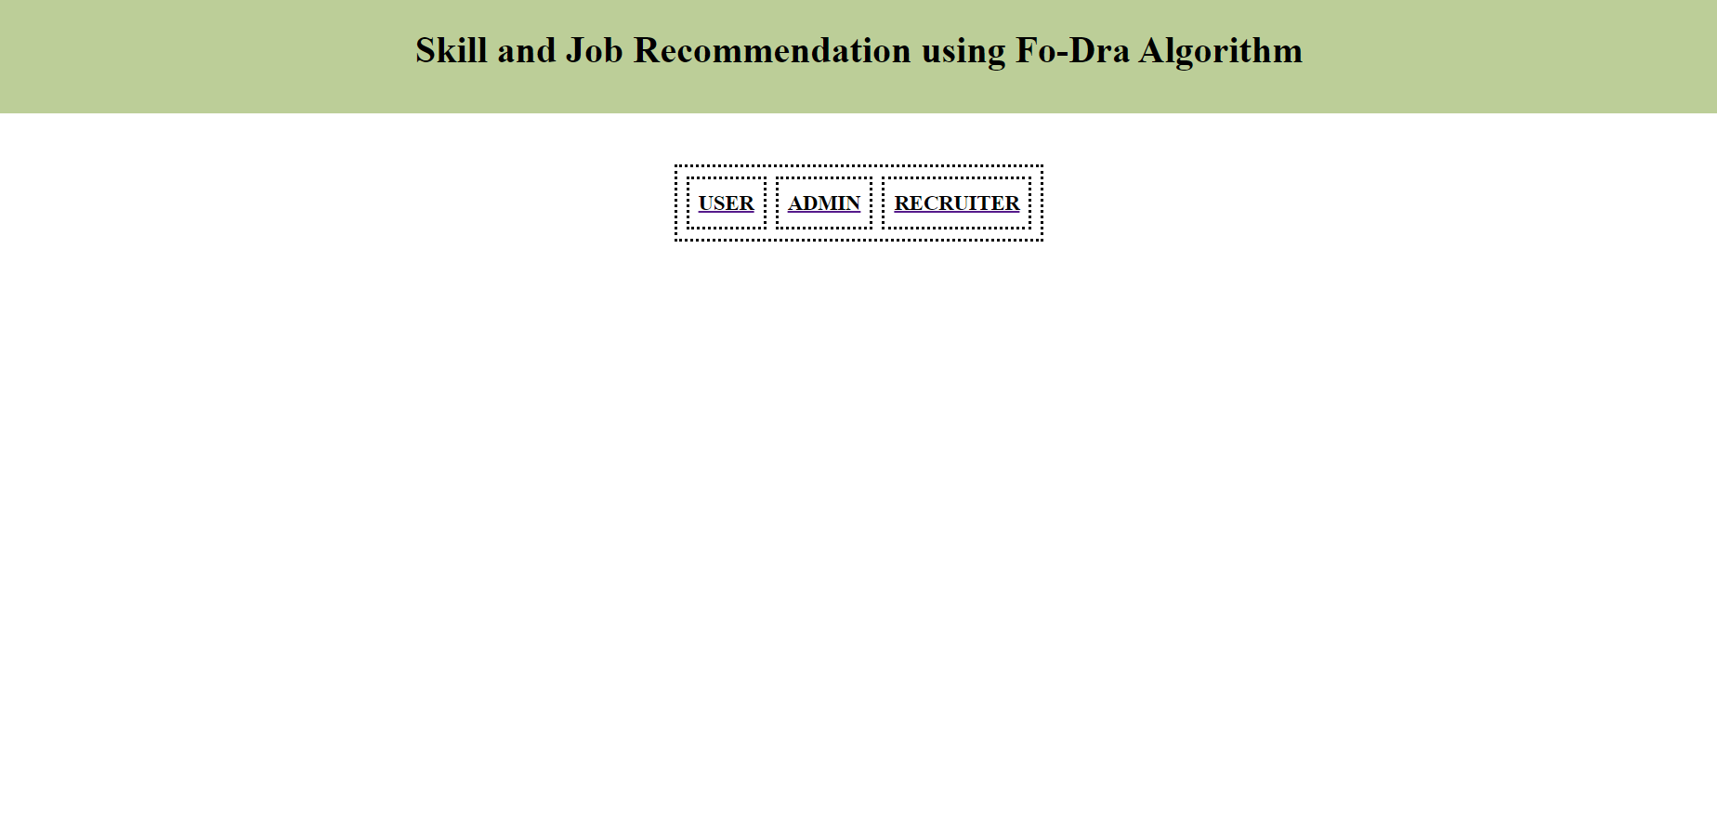
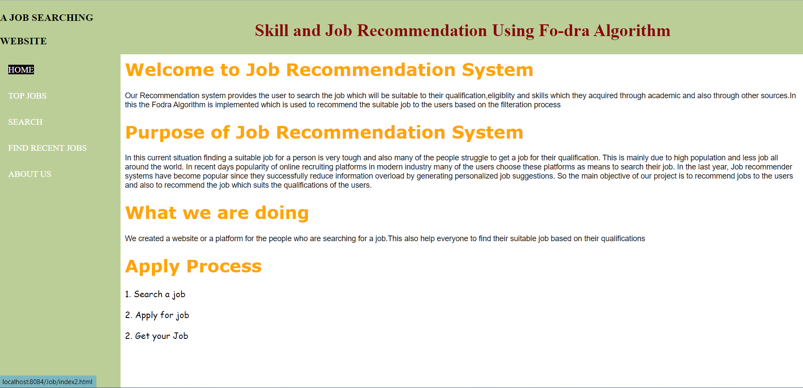
OUTPUT
Welcome page
Home Page

Slide 20
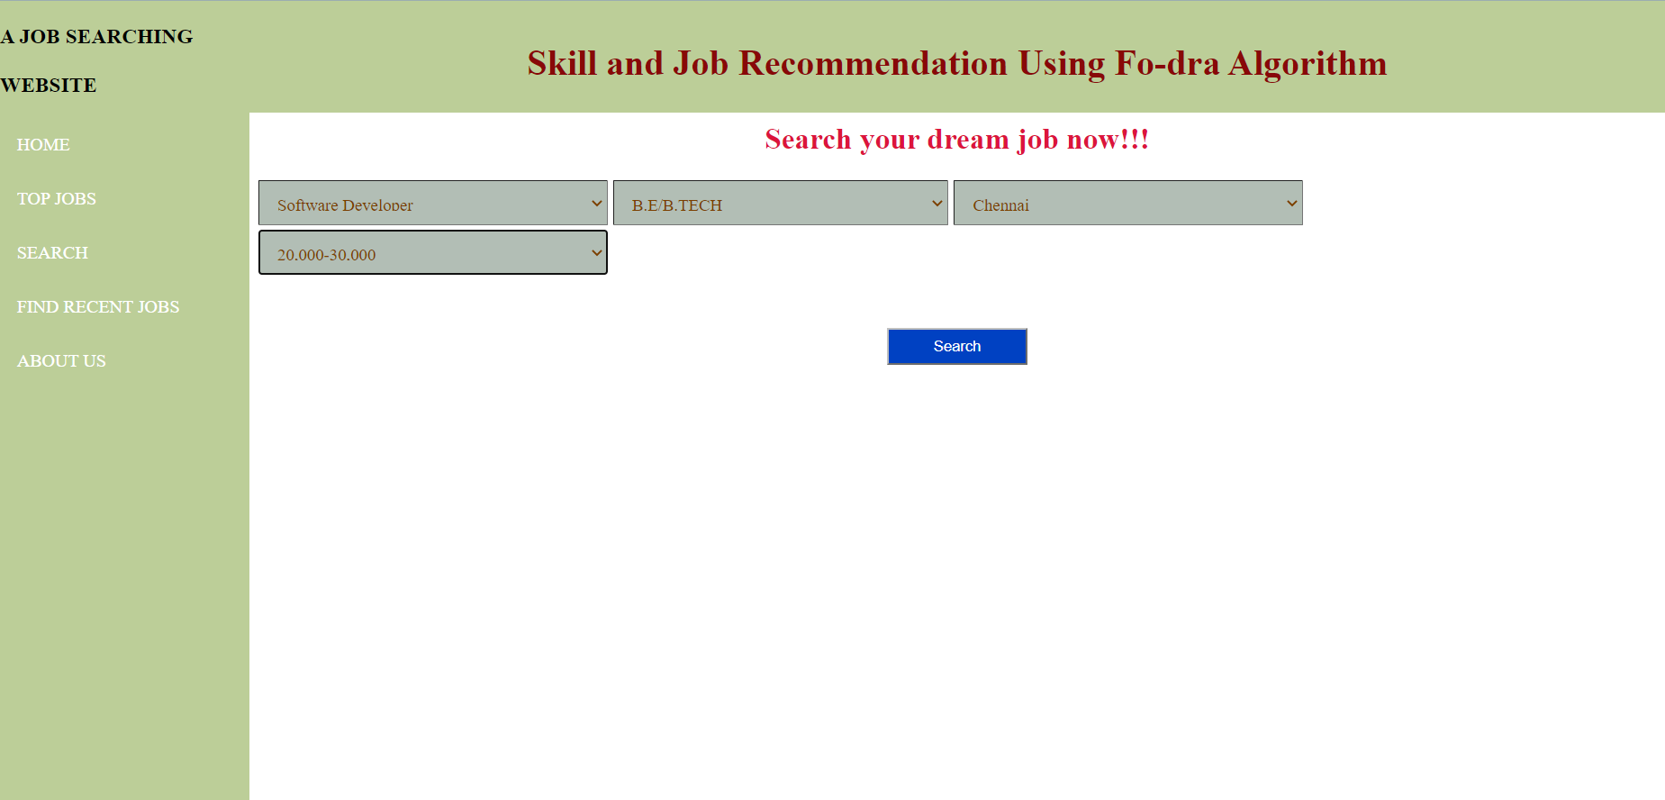
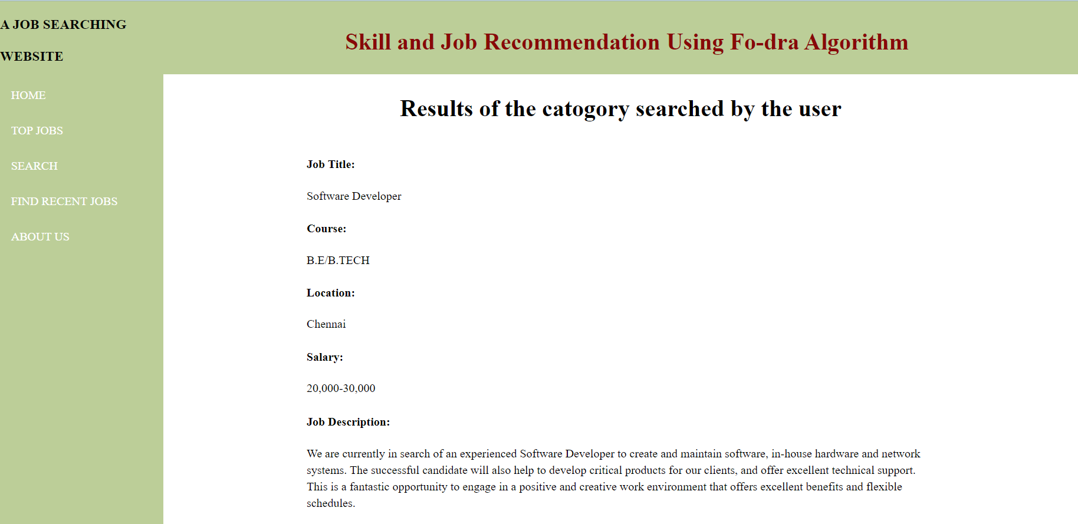
Search Page
Result Page

Slide 21
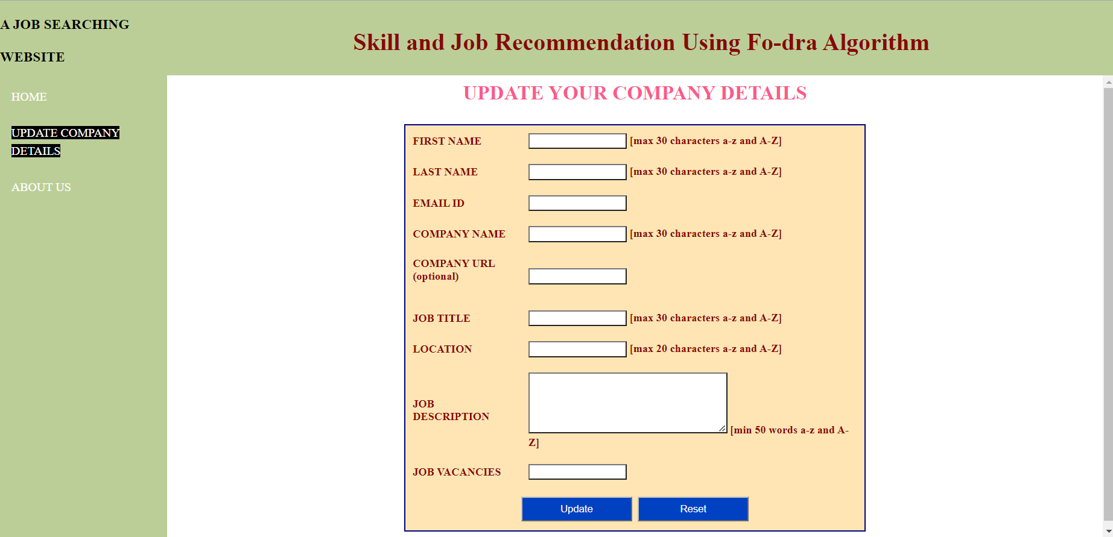
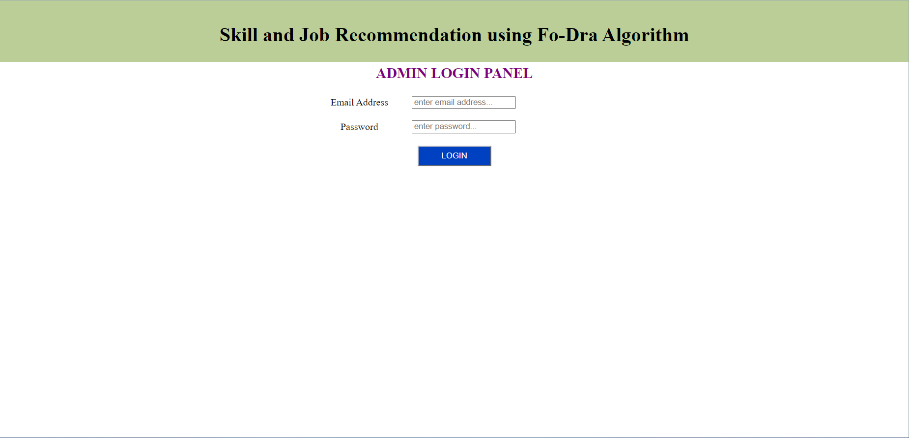
Recruiter Job Posting Page
Admin Login page

Slide 22
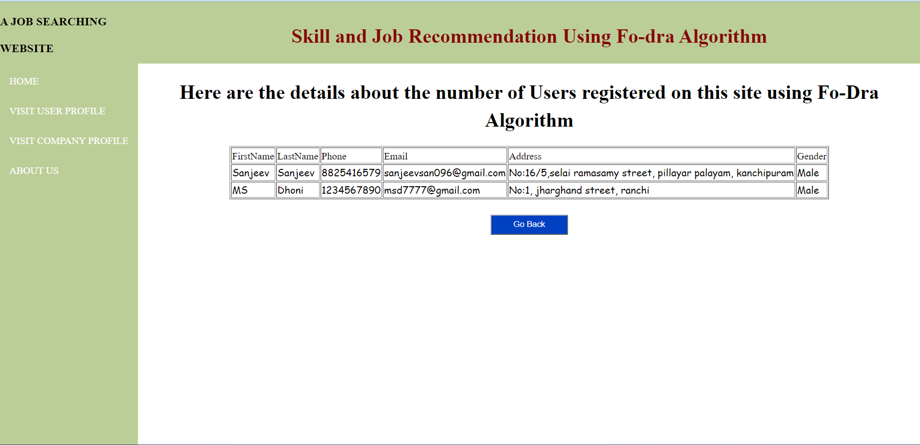
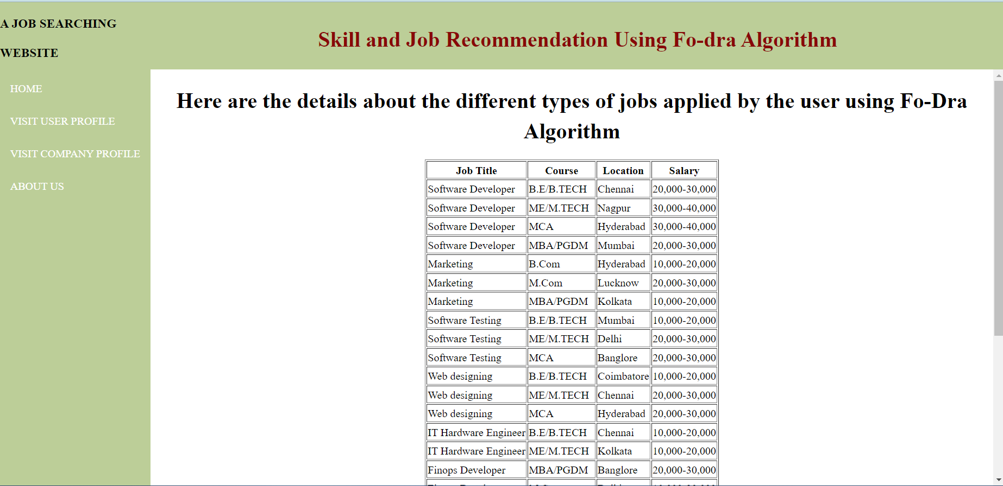
User Registration Viewing Page
Jobs applied by user viewing Page

Slide 23
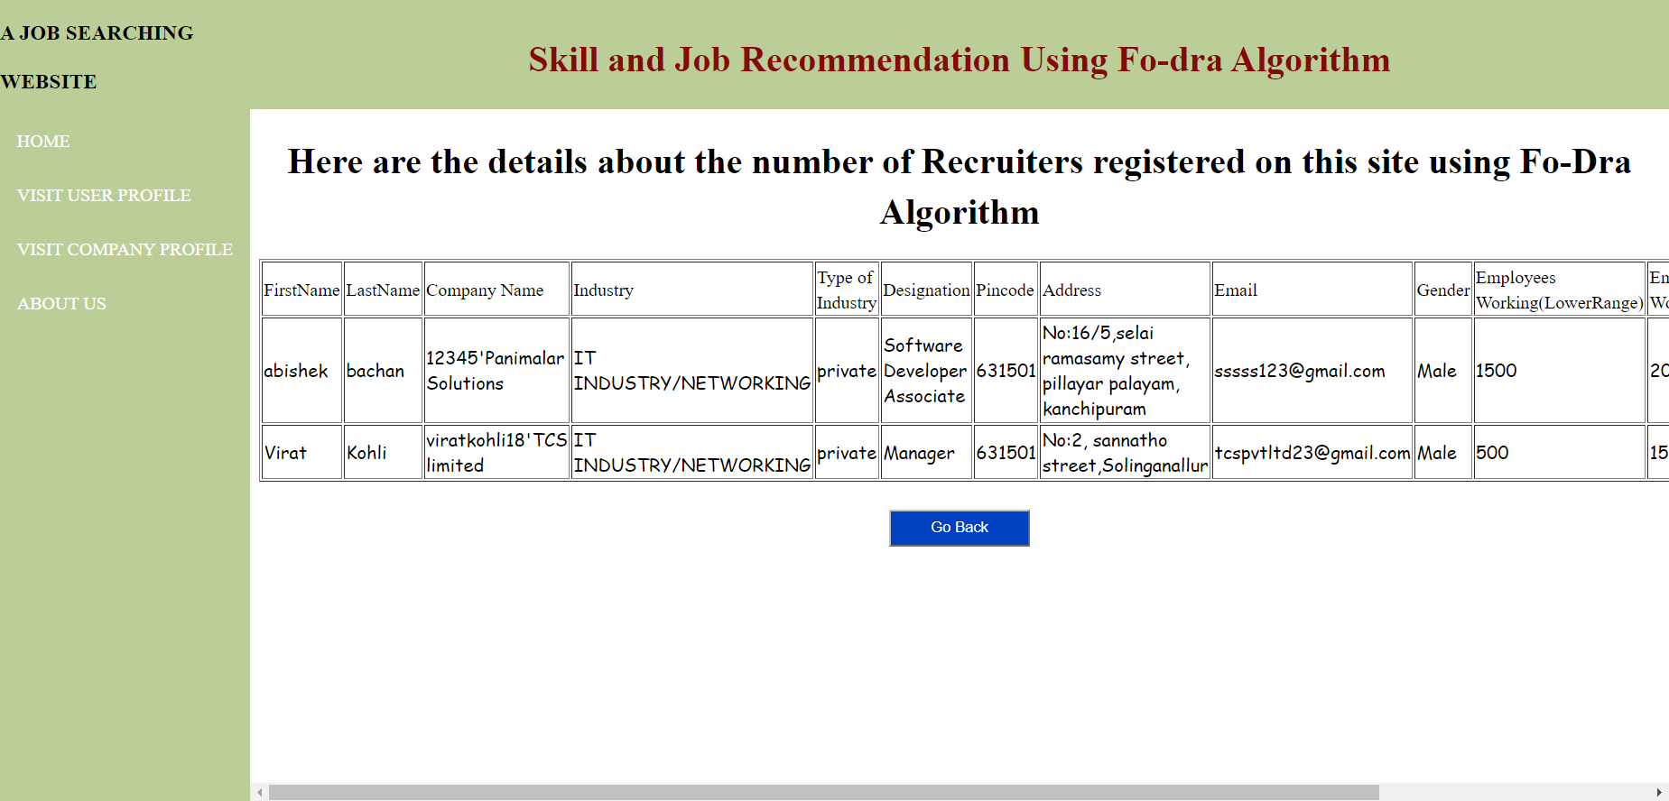
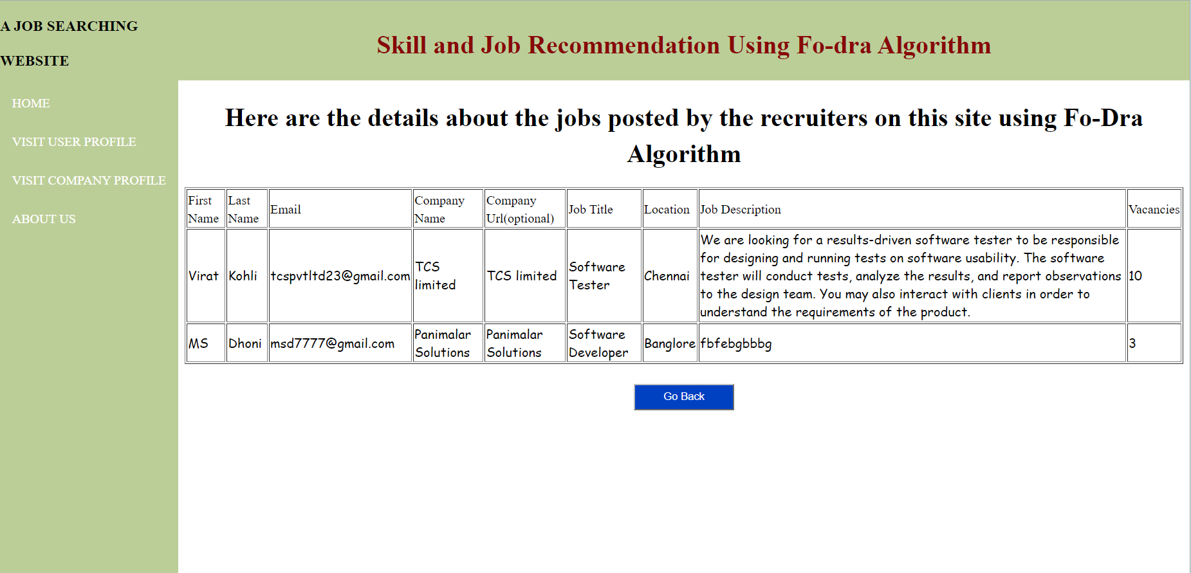
Recruiter Registration Viewing page
Jobs Posted by Recruiters Viewing Page

Slide 24
CONCLUSION
FoDRA is an excellent algorithm to develop a job recommendation algorithm.
Whenever there are lot of criteria’s to be considered FoDRA algorithm is the perfect one to recommend the users a suitable job for them. In this project, we managed to develop a prototype which recommends the perfect job for the users based on their skills, required location and job title which was the essential feature the user sees to get the job.
To further optimize the recommendation system, and integrate the system for better performance we keep in check the sparsity of user profile and use some methods for filling user’s preference matrix and how it can be utilized.
Thus the current drawbacks in the Job recommendation system are being overcome and the recommendation system is being enhances in our Skill and job recommendation system using FoDRA algorithm project which can be easily accessed by the users.

Slide 25
REFERENCES
Efficient and Scalable Job Recommender System Using Collaborative Filtering published by Ravita Mishra and Sheetal Vikram Rathi on may 2020.
FoDRA - A new content – based job recommendation algorithm for job seeking and recruiting published by Nikolaos D. Almalis, George A. Tsihrintzis, Nikolas Karagiannis, Aggeliki D. Strati on 2020.
Java Server pages (JSP) tutorial from the Great Learning Blog published by Great Learning Blog team on October 31st 2022.
NetBeans Online Training and SQL tutorial published from tutorial point by Malhar Lathkar and her team on February 2020.
Common uses and defining features of HTML published in Code Academy by Code Academy and its team on 26th April 2021.
CSS: Cascading Style Sheets published in MDN web docs by the team of MDN web docs and its associations on February 2023.

